Slide 1
Analyzing Architecture
Unit IV
Theory of Architecture II

Slide 2
PRINCIPLES OF BUILDING PLANNING
Then architect prepares design of a building with the help of the following principles of planning.
Aspect
Prospect
Privacy
Roominess
Grouping
Circulation
Furniture requirement
Flexibility
Sanitation
Elegance
Economy

Slide 3
1. ASPECT
Disposition of doors and windows in the external walls – occupants can enjoy the gifts of the nature viz; sun-shine, breeze, view of landscape etc.
SUN RAYS ADMITTED INTO KITCHEN
ASPECT – EAST SIDE
KITCHEN
EAST SIDE

Slide 4
ASPECTS FOR DIFFERENT ROOMS
NORTH
STUDY ROOM
STORE
STAIR CASE
WEST
EAST
BED ROOMS
KITCHEN
LIVING,
VERANDAH
SOUTH

Slide 5
2. PROSPECT
WINDOW AT HIGHER LEVEL
OUTSIDE VIEW SEEN FROM INSIDE OF THE ROOM
OUTSIDE GREENEARY CANNOT BE SEEN FROM INSIDE, HENCE NO PROSPECT
FLOWER BED

Slide 6
PROSPECT CONTD…
WINDOW TAKEN TO LOWER LEVEL
OUTSIDE GOOD SCENES, GREENARY CAN BE SEEN BY SITTING INSIDE THE ROOM, HENCE GOOD PROSPECT
FLOWER BED

Slide 7
PROSPECT CONTD…
INSIDER OBSERVER
INSIDE OBSERVER
INSIDE OBSERVER
LESS VIEW DESIRED
LARGE VIEW DESIRED
CONCEALING UNDESIRABLE VIEW

Slide 8
3. PRIVACY
Exposure of the interior space / room to the visitors vision
Types of privacy:
(1) Privacy of all parts of building with reference to surrounding buildings, roads etc.
This type of privacy can be achieved by--
Growing plants, trees etc
Providing high windows with respect to roads, grounds etc.
(2) privacy of one room from another room:
This type of privacy can be achieved by—
Carefully positioning of doors & windows

Slide 9
Privacy depends on placement of doors /window openings
OBSERVER
OBSERVER
OBSERVER
MODERATE
PRIVACY
MAX PRIVACY
NO PRIVACY

Slide 10
PRIVACY CONTD…
Internal privacy can be achieved by
Providing curtains
Providing screens
Avoiding windows in interior walls of the room

Slide 11
4. ROOMINESS
Getting maximum benefit from minimum dimensions or space of room
Rectangular shaped room gives feeling of more space than square shaped room for the same area
MORE AREA AVAILABLE
LESS AREA AVAILABLE

Slide 12
5. GROUPING
Arrangement of various rooms in relation with their functions
GOOD GROUPING
IMPROPER GROUPING
KIT
DIN
S.B.
BED
KIT
BED
S.B.
DIN
LIVING
STAIR
LIVING
STAIR

Slide 13
6. CIRCULATION
Horizontal circulation – passages, corridors, verandahs etc.
Vertical circulation – stairs, lifts, escalators etc.
DOOR
DOOR
DOOR
BAD CIRCULATION
GOOD CIRCULATION
HORIZONTAL CIRCULATION

Slide 14
6. CIRCULATION CONTD…
VERTICAL CIRCULATION
N
STUDY
KIT
STUDY
KIT
LIV
LIV
BED
VER
BED
VER
GOOD CIRCULATION WITH STAIR INSIDE
BAD CIRCULATION WITH OUTSIDE STAIR

Slide 15
7. FURNITURE REQUIREMENT
Function of the Room decides the Furniture requirement of that room
Liv hall – sofa set, teapoy, tv case, showcase, diwan etc.
Bed – single, double beds, dressing table, almirah etc.
Dining – dinning table, chairs, cupboards etc.
Knowing type of furniture the dimensions of the room can be arrived at.

Slide 16
8. FLEXIBILITY
To facilitate accommodation of changes in the plan of the building in future if necessary
ROOM 1
BIG HALL
ROOM 2

Slide 17
9. SANITATION
LIGHTING
NATURAL LIGHTING
ARTIFICIAL LIGHTING
VENTILATION
NATURAL VENTILATION
ARTIFICIAL VENTILATION
CLEANLINESS
SANITARY PROVISIONS
BATHS-ROOMS
WATER CLOSETS
LATRINES

Slide 18
10. ELEGENCE
ELEGANCE MEANS THE AESHTETIC VIEW OF THE BUILDING OR THE BEAUTY OF THE BUILDING
ELEGANCE OF THE BUILDING CAN BE ACHIEVED BY
INCREASING THE PLINTH HEIGHT OF BUILDINGS
TREATMENT OF EXTERIOR OF BUILDING – SLOPING ROOF, PROJECTIONS ETC.

Slide 19
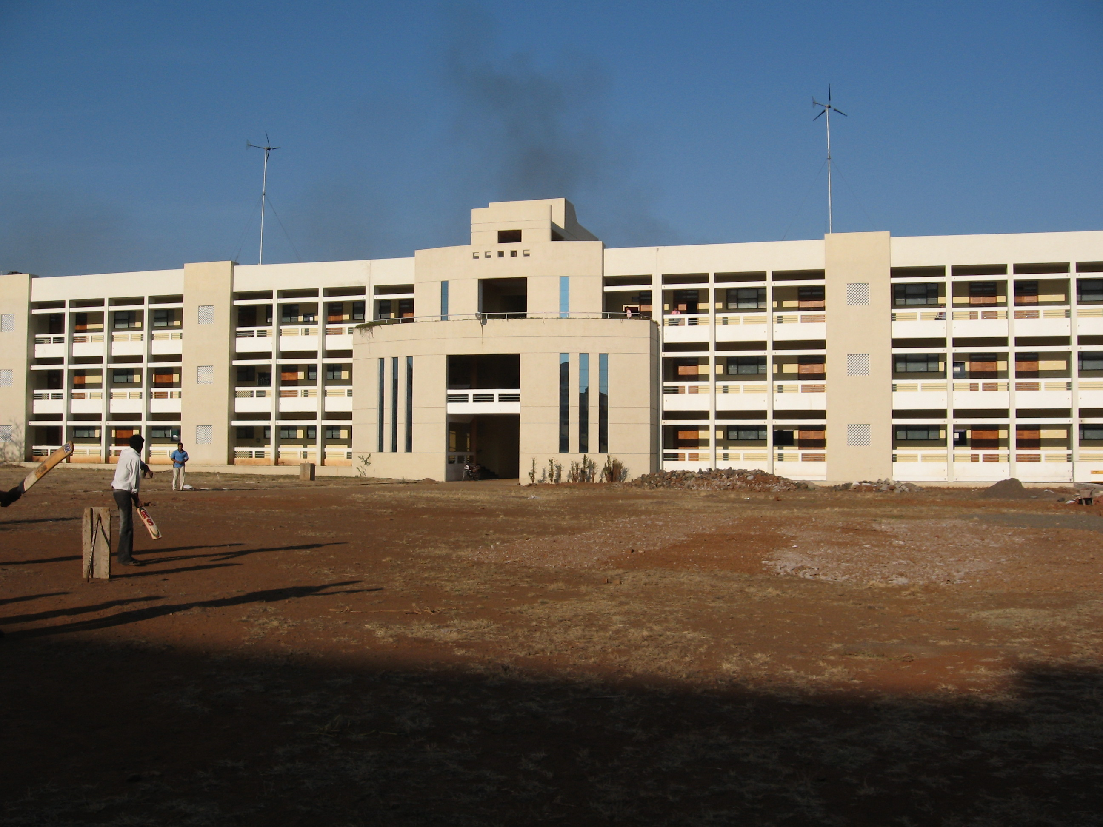
ELEGENCE : CLASSROOM BUILDING

Slide 20
11. ECONOMY
MINIMUM DIMENSIONS OF THE ROOM, DOORS, WINDOWS,
SIMPLE DESIGN OF WINDOWS,
PROVIDING MINIMUM HEIGHT OF BUILDING
AVOIDING PORCHES, LOBBIES ETC

Slide 21
Thank You

